Slide 1

CAPSTONE PROJECT: NBA PLAYER ANALYSIS & Hall Of Famer Predictions
General Assembly DSI 14
June 29, 2020
Chan Song Yuan

Slide 2
TABLE OF CONTENTS
01
02
PROBLEM STATEMENT
EXPLORATORY DATA ANALYSIS
03
04
MODELING AND RESULT
CONCLUSIONS & RECOMMENDATION
Problem statement for the Capstone Project
What data set obtained, EDA to decide the features to apply in to the modeling
The modeling selections with best parameters and results

Slide 3
Problem Statement
For this capstone project, I want to predict which NBA players will have higher probability to get nominated as Hall Of Fame in the near future.
Which features in the data sets to be chosen ?
Player performance ?
Regressions / Classifications?

Slide 4
EXPLORATORY DATA ANALYSIS
EDA helps to identify which features had higher importance for Hall Of Famer Predictions. Some analysis on players performance

Slide 5
Data Sets
Seasons_Stats
player_data
Players
Data sets which obtained from Kaggle
The kaggle user scraped the data from Basketball Reference.com
Data available from year 1950 - 2017
Shape : 24691 x 53
Players stats recorded in yearly manner
Glossary as reference for each feature in the data set,
Shape : 4550 x 9
Players positions, height, weight
Birthdate, college, year start, year end
Shape : 3921 x 8
Players height, weight
Birthdate, college, year born, birth city, birth state

Slide 6
Some Notable Rules Change Due To Player Dominance
Reddit
Nba Archive
1954-1955
1964-65
2000-2001
2001 - 2002
24 Seconds shot clock and penalty free throw introduced
Free Throw Line moved from 12 to 16 feet, forbid to cross free throw line when perform FT
The Booty Rule / Mark Jackson Rule (5 seconds violations)
The Defensive 3-Second Rule
This is prevent the trailing team to foul deliberately
Offensive player with the ball and not facing-up starts dribbling below the free throw line extended while being closely guarded or starts dribbling outside and then penetrates below the free throw line extended while being closely guarded
Defence player not allowed to stay in the restricted area for more than 3 seconds. (Shaquille O’Neal dominace)
Wilt would throw it against the backboard for dunks

Slide 7
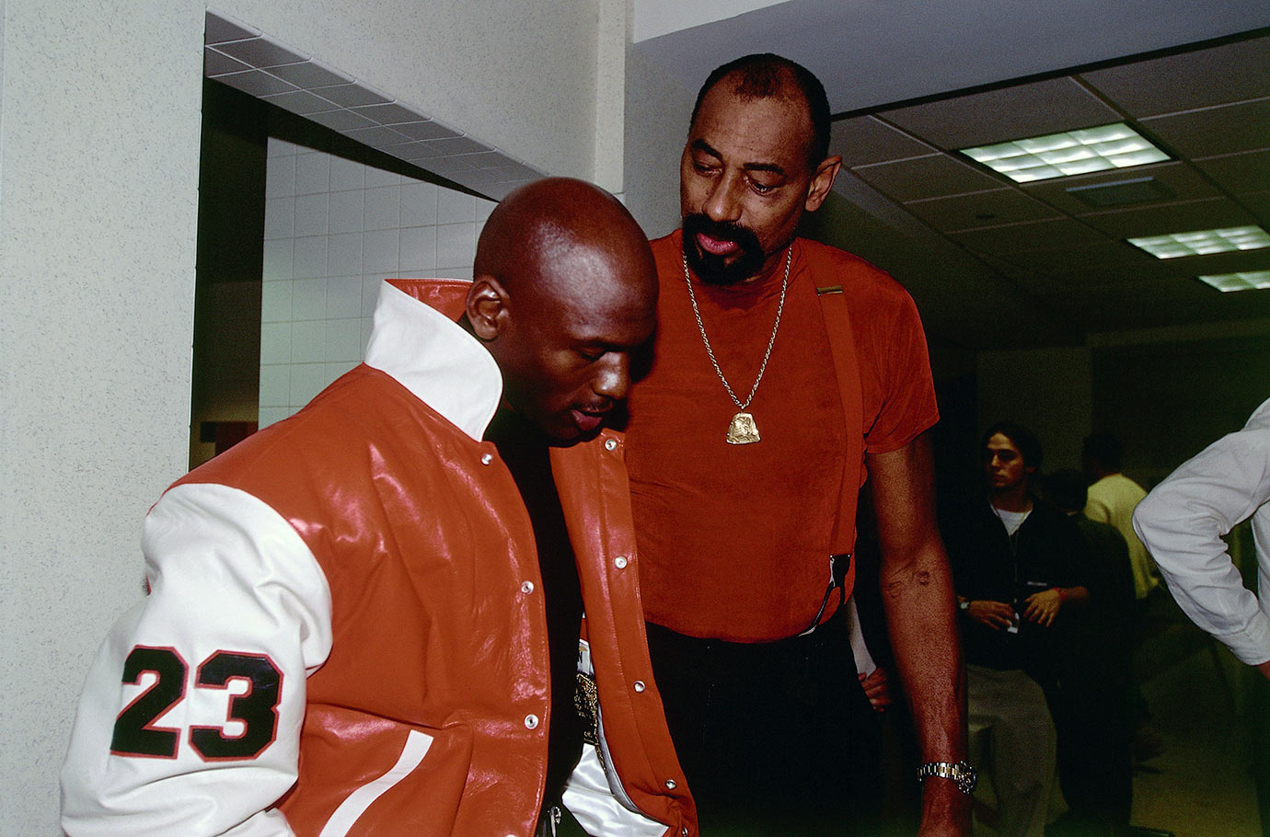
“Just remember Michael. When you played, they changed the rules to make it easier for you to dominate. When I played, they changed the rules to make it harder for me
”
Wilt Chamberlain

Slide 8
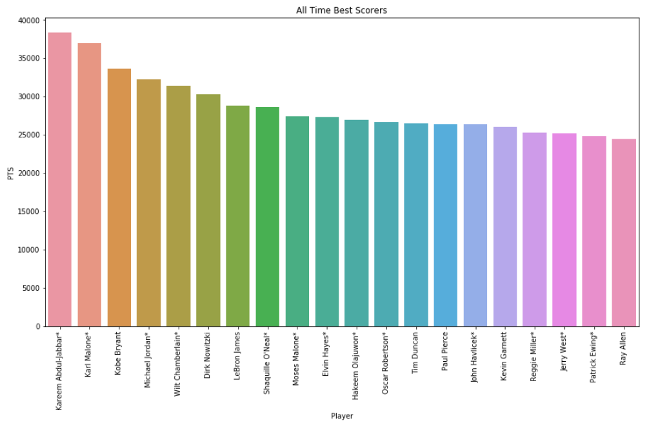
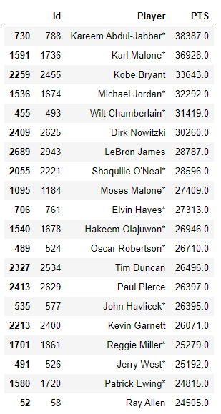
All Time Scorers

Slide 9
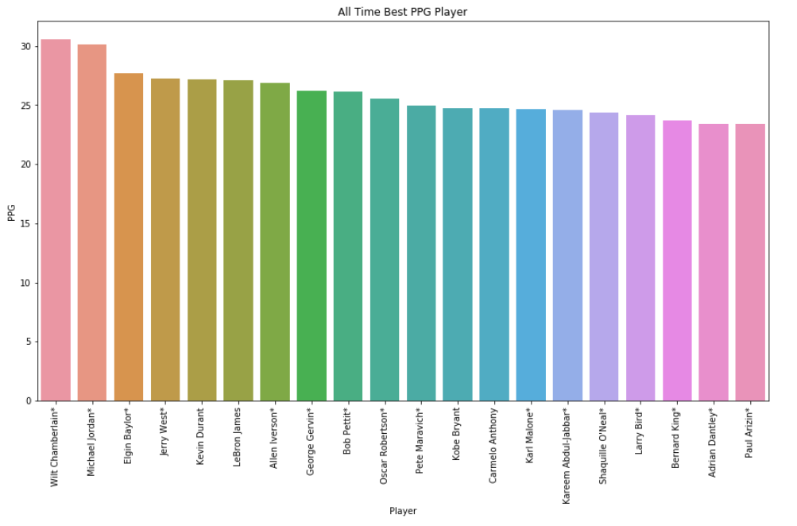
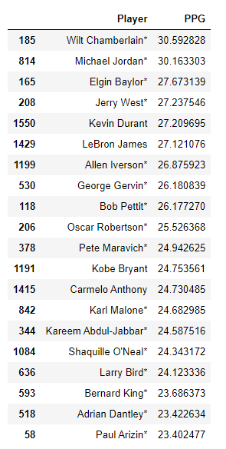
All Time Efficient Scorers

Slide 10
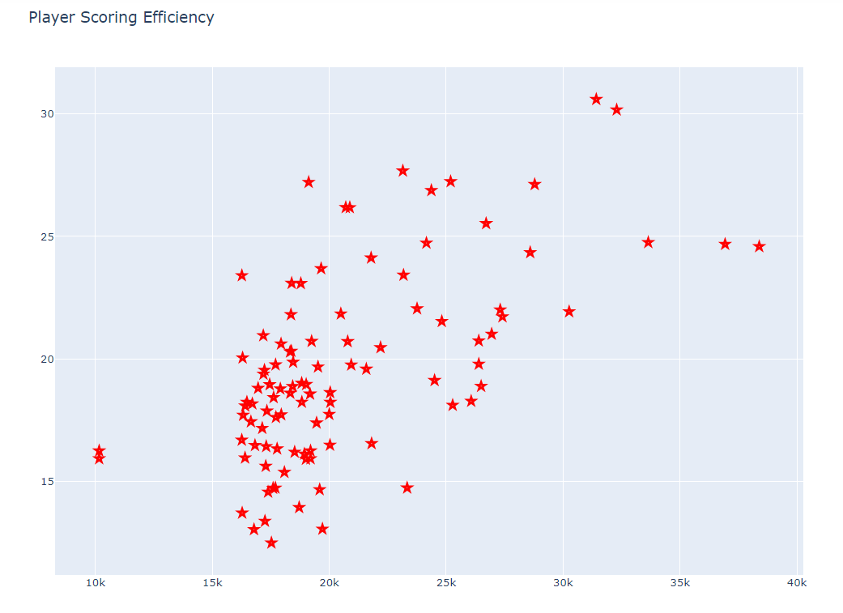
Scoring Efficiency vs Total Points
Tableau Link

Slide 11
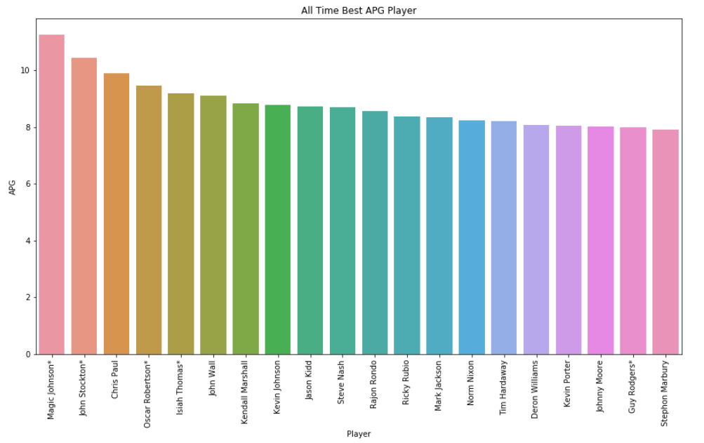
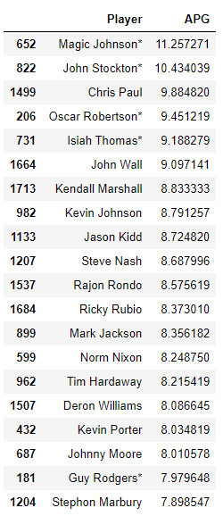
All Time Efficient Assistant

Slide 12
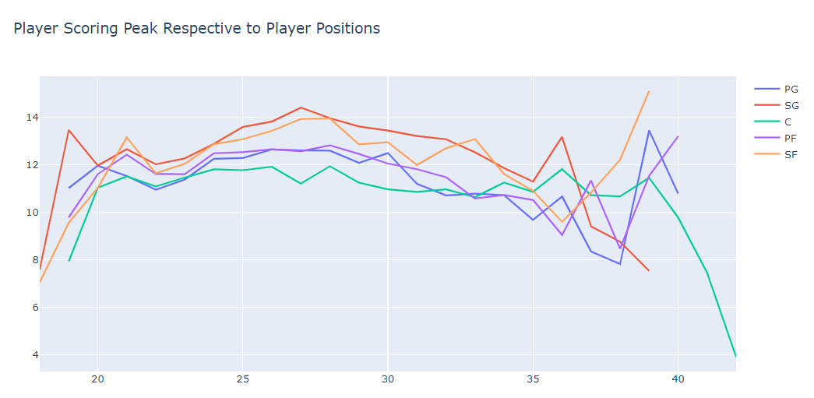
Player Scoring Peak Age On Different Position

Slide 13
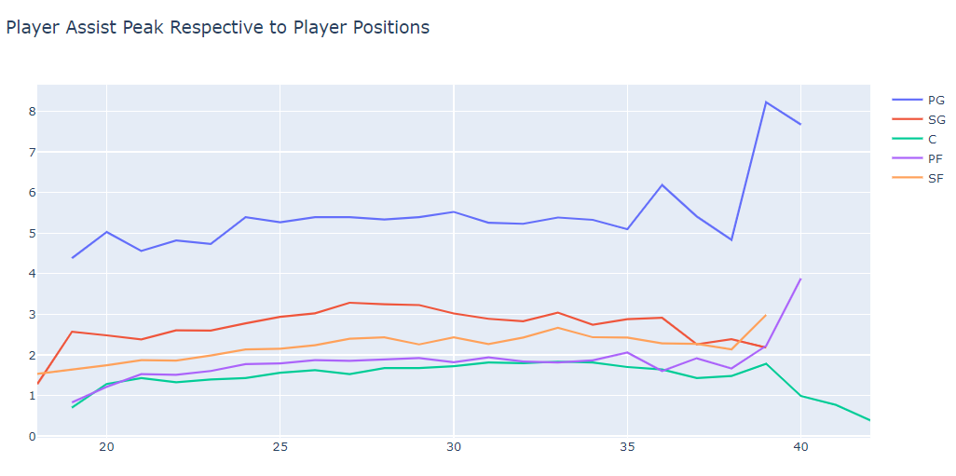
Player Assist Peak Age On Different Position

Slide 14
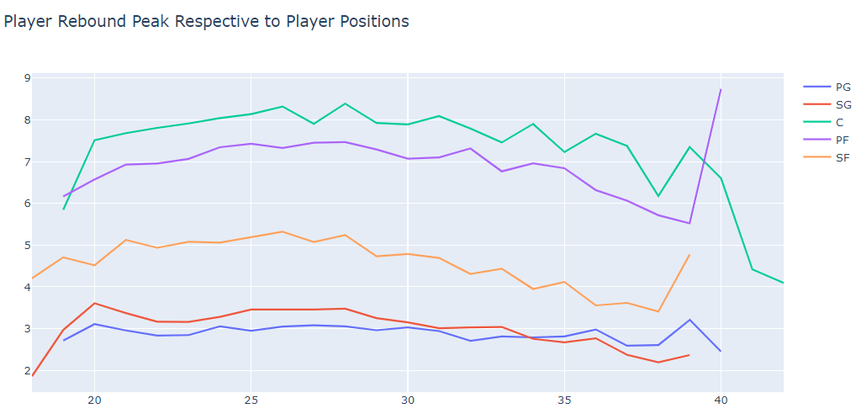
Player Rebound Peak Age On Different Position

Slide 15
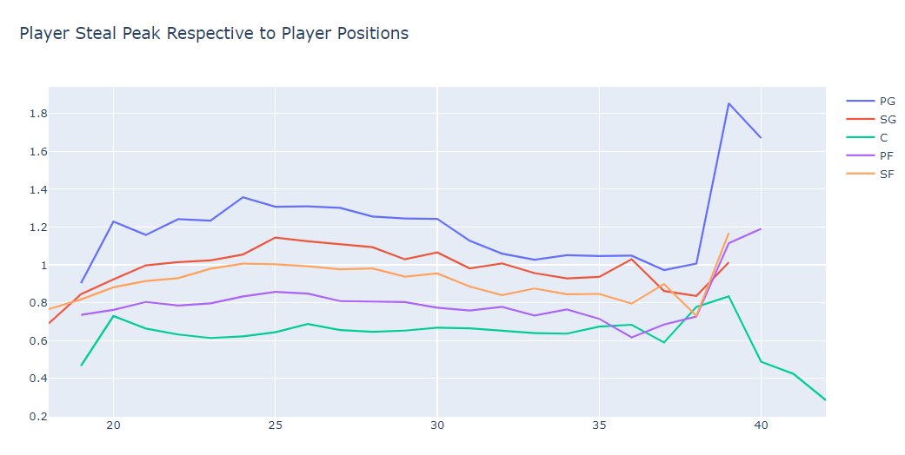
Player Steal Peak Age On Different Position

Slide 16
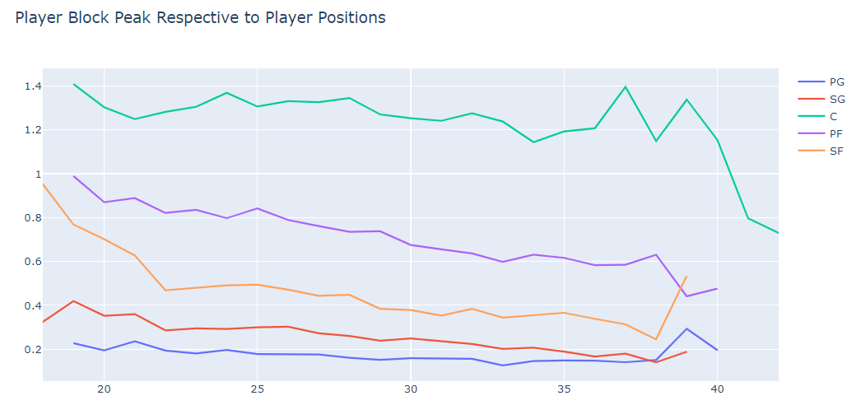
Player Blocking Peak Age On Different Position

Slide 17
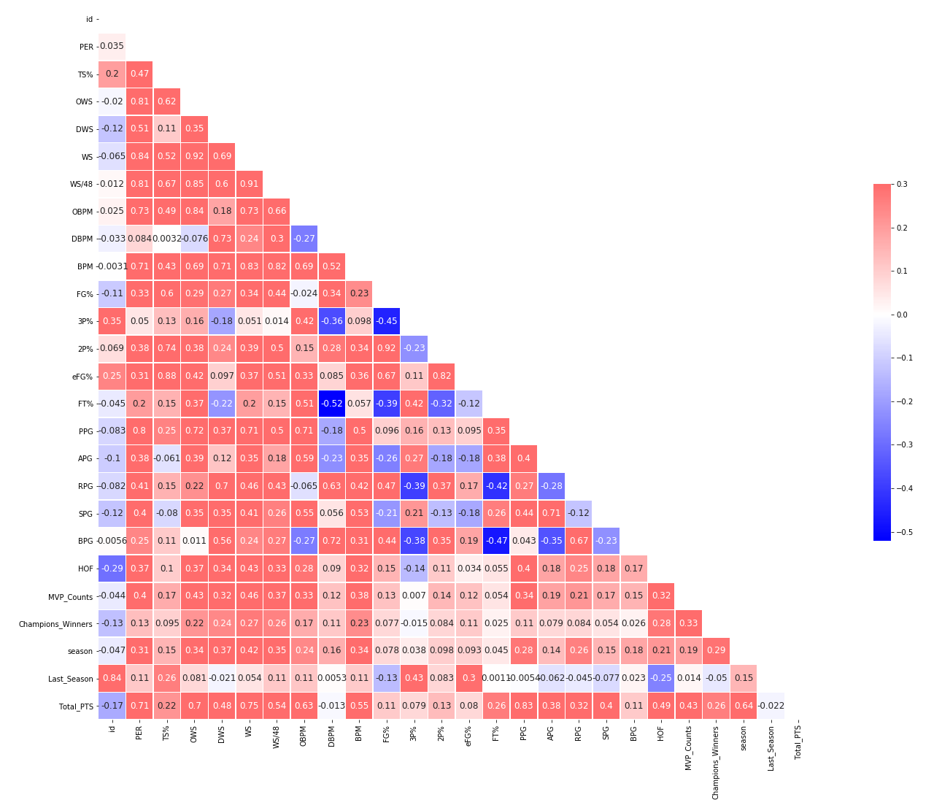
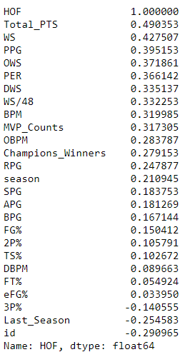
Correlations Heatmap

Slide 18

Train Test Split
Train Data : Players who retired before 1997 or the players who nominated as Hall Of Famer
Test data : Players who continued or start playing in NBA after 1997 and players who were not nominated as Hall Of Famer
WHY So?
* Michael Jordan was retired after 1997-1998, but came out of retirement to play for Washington Wizards in 2001.
But as a player, he proved he could still compete with the best in the NBA despite playing for the Wizards at Age 38 and 39. In his first season, he averaged 22.9 points in 60 games with 5.7 rebounds, 5.2 assists and 1.4 steals. His second and final season saw him average 20.0 points, 6.1 rebounds and 3.8 assists. He played 37 minutes a night and appeared in all 82 games.

Slide 19
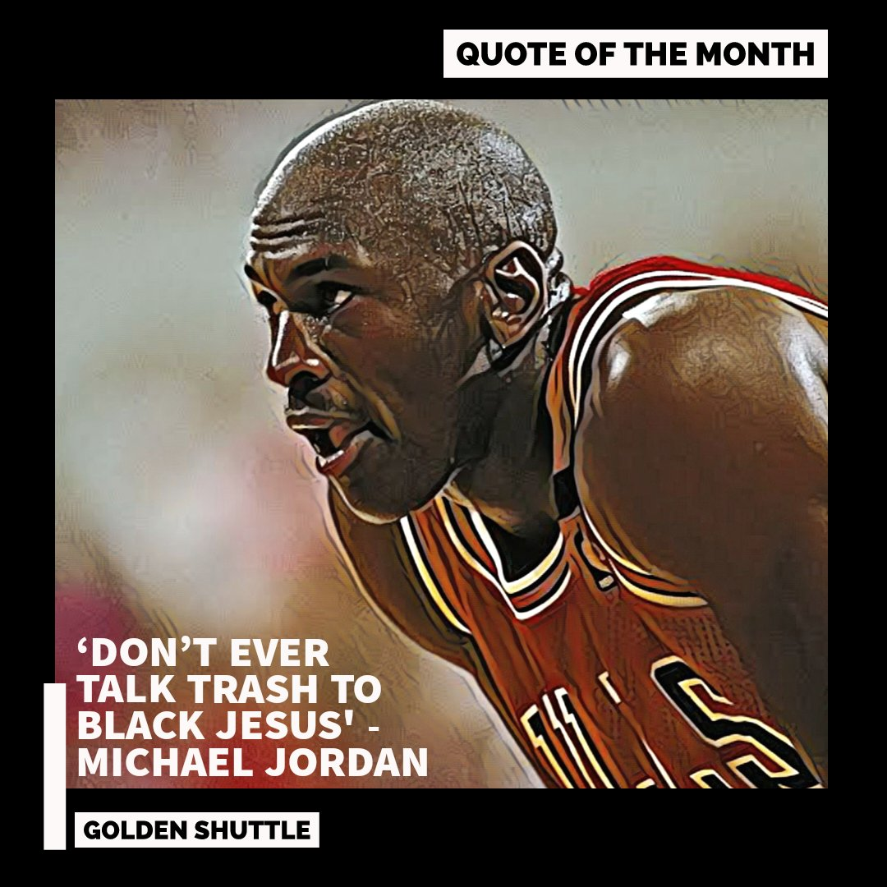
This happened when Indiana Pacers Rookie, Reggie Miller , trash talking to Michael Jordan about MJ’s 1st half performance, but in the end of the game MJ outscored the rookie 44-12.
40 -2 in the 2nd Half…
In NBA 1997-1998 season

Slide 20
MODELING AND RESULT

Slide 21
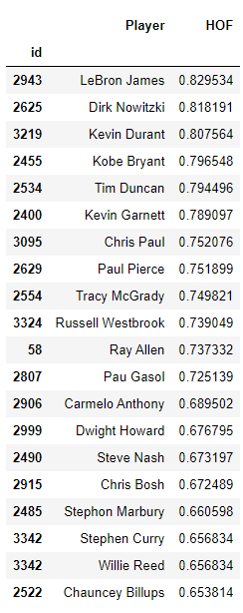
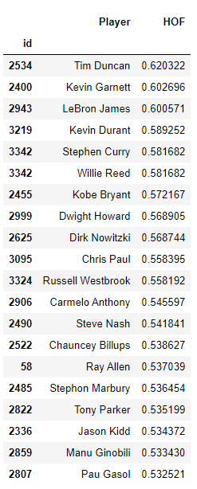
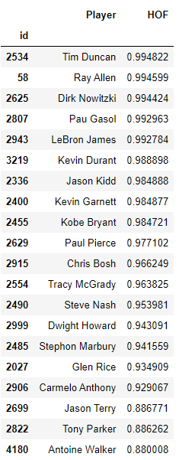
Modeling Analysis
Random Forest Classifier
Train Score : 0.9105
AdaBoost Classifier
Train Score : 1.0
XGBoost Classifier
Train Score : 1.0

Slide 22
Modeling Analysis
MODELS | BEST PARAMS | Train Score | Results Analysis
Random Forest | 'rf__max_depth': 2, 'rf__max_leaf_nodes': 3, 'rf__min_samples_leaf': 1, 'rf__n_estimators': 10000 | 0.9105 | The train score is lower but the results seems acceptable, but by comparing with XGBoost Classifier model, the probability results is lower.
AdaBoost | 'ada__learning_rate': 0.7, 'ada__n_estimators': 10000 | 1.0 | Even though the train score is 1.0, but the probability were lower than 0.7
XGBoost | eval_metric = ‘auc’, scale_pos_weight = 0.4, 'xg__learning_rate': 0.6 | 1.0 | The train score is 1.0 and comparing the results, the probability by XGBoost Classifications seems perform better than other 2 models

Slide 23
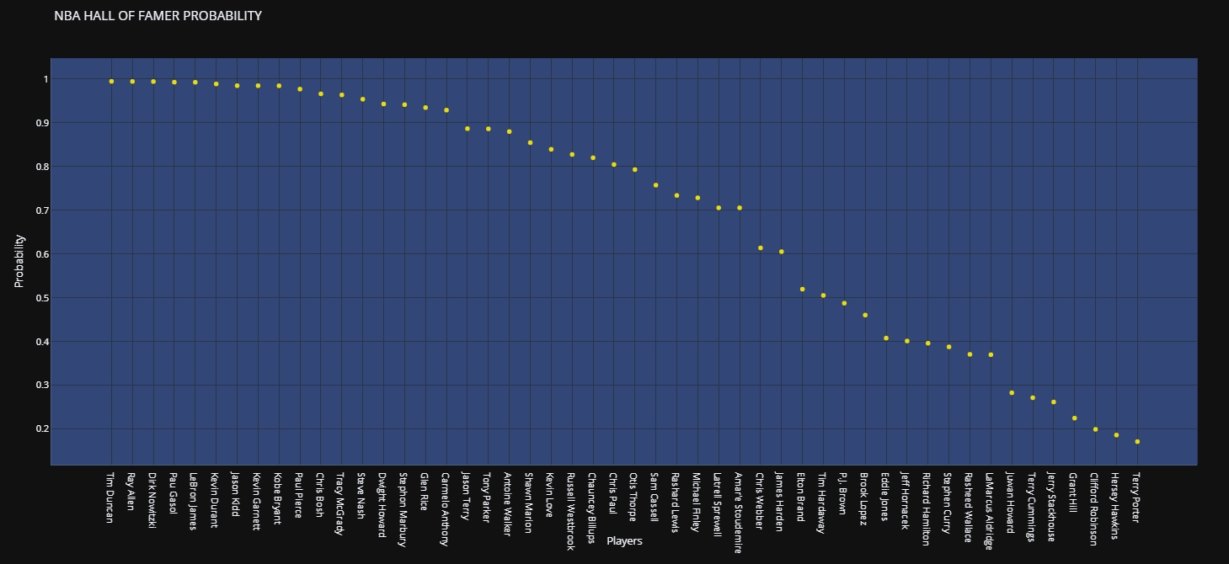
Plotly

Slide 24
CONCLUSIONS

Slide 25
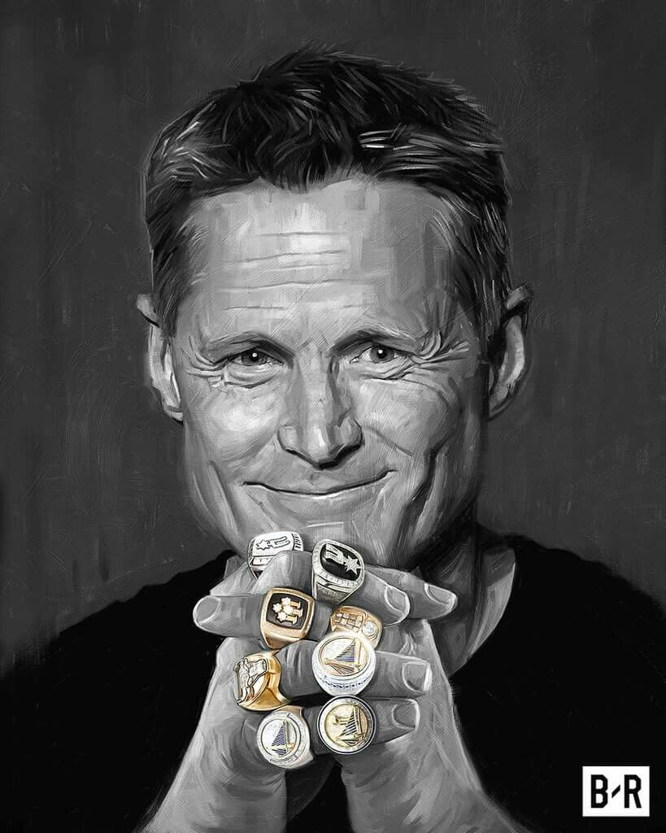
Fun Fact!
Lord Of The Rings
Which Player won the most rings ?
Michael Jordan
Kobe Bryant
Tim Duncan
Shaquille O’Neal
Steve Kerr
Lebron James
6 Rings
5 Rings
5 Rings
4 Rings
8 Rings !!!
3 Rings

Slide 26
THANKS

